Slide 1


On the way to more robustness
adjusting the traffic
risk sharing scheme
Seregélyes, Kálmán

Slide 2

Introduction: THE EU FRAMEWORK FOR ANS regulation
1
EU regulation 2019/317 lays down the legal basis for the performance scheme
Performance is divided into KPAs: Safety, Environment, Capacity, Cost-Efficiency
For each areas KPIs are used to set targets: EU-wide and on national level
States have to prepare Performance Plans with targets for Reference periods (RPs) with 5 years
A plan includes commitments for each KPA in form of targets and it also includes operational details such as cost and traffic assumptions for the entire RP
2
3
4
5

Slide 3
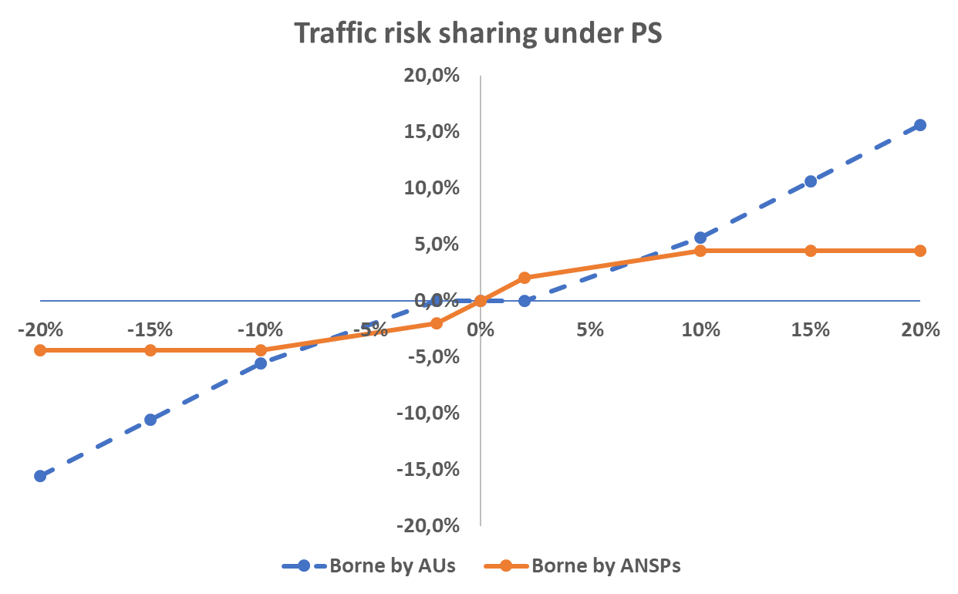
TRAFFIC RISK SHARING UNDER THE PERFORMANCE SCHEME
Traffic variations have direct or indirect effects in all of the areas, but explicitly it apears in the cost-efficiency domain
Stepwise scheme:
ANSPs risk is limited at 4,4%

Slide 4
ChARACTERISTICS OF THE CURRENT TRAFFIC RISK SHARING SCHEME
Risk is shared between ANSPs and AUs
Risk profile is subject to changes in traffic compared to Performance Plan
The higher the change, the lower share falls onto ANSPs, more goes with AUs
The highest share (100%) is borne by ANSPs for minor changes in traffic (0±2%)
Risk is capped for ANSPs (max 4,4%), after a limit (-10% or 10%) no additional loss or gain in revenue

Slide 5




Why THE CURRENT TRAFFIC RISK SHARING SCHEME needs a change
Risk is not borne by the party most capable to handle it
  Risk sharing is not in line with cost to traffic elasticity of ANSPs
  Traffic risk under the Performance scheme is de facto a Risk of reliable forecasting and not the risk of traffic (demand) evolution
  AUs have no influence on the size of the risk, nor means for mitigation
  Cost of suboptimal risk sharing is borne by airspace users in form of risk premium embedded into cost of capital of ANSPs
  Traffic planning is distorted by the inappropriate risk sharing scheme

Slide 6
A possible Way forward: adjust TRS ratios
The traffic risk borne by ANSPs should be in line with their cost elasticity to traffic.
First of all, a new TRS ratio has to be set after thoroughly analysing the nature of the evolution of costs compared to traffic.
The ultimate goal is to increase the ability of ANSPs to mitigate the effects of traffic risk.
ANSPs extra revenue shall be in line with the additional costs to be covered. Appropriate risk hedging

Slide 7
A possible Way forward: step in of the public
The financial consequences of traffic variation should be settled by means of a centrally managed supranational fund.
In the absence of appropriate stakeholder for risk mitigation, the remaining share of traffic risk shall be borne by the largest community concerned.
The proper functioning of aviation, including ANS is in the interest of larger economic areas, such as the EU.
Raising the traffic risk sharing at a higher level leads to less traffic volatility.
Unlike the current scheme, AUs would not be subject to TRS. The fund would actually take the traffic risk for the whole EU and it would redistribute the financial effects triggered by traffic in individual countries.
Less risk at lower costs.

Slide 8
A possible Way forward: improving financing
Besides having inflows and outflows due to traffic deviations, the EU fund should be able to acquire financial facilities on its own.
To be prepared for recessions or even times of crisis (when there is system-wide no excess revenue from better than planned traffic), the fund should possess further financial facilities. By this the fund could
  Lower financing costs
  Act as an anticyclical tool.

Slide 9
benefits of the proposed scheme

Slide 10
THANK YOU FOR YOUR ATTENTION
For a more detailed description:
https://www.network-industries.org/wp-content/uploads/2023/11/NIQ-Vol-25-Issue-3-October-2023.pdf

